Slide 1

By
B BHARATH REDDY (18C21A0504)
B RAHUL (18C21A0505)
R VENU (18C21A0540)

Slide 2
ABSTRACT
Tech repository is a mobile application which is used to maintain the required material for the users who need to attend an interview.
It is also usefull to the software engineers who are working on coding.
Its main theme is to provide maximum knowledge of technical side which includes programming Data, syntaxes and other useful data.

Slide 3
INTRODUCTION
All the important material is given to them in the form of an android application in order to enable them to keep as a handy tool to refer the important concepts.
The user can select the language which he wants to refer for ex: c, c++ ,java , Dbms etc.
Our application covers all the important information to acquire knowledge in that particular computer programming language.

Slide 4
EXISTING SYSTEM
In the existing system the concentration is made only on that particular language
It cannot be used for fast reference as people might end up searching for required apps and materials wasting time
They cant be used for quick and easy reference
Complete pdf should be downloaded to read them which contributes for wastage of memory

Slide 5
DISADVANTAGES
Previously existing apps provide only single subject.
For referring two or three subjects we need to download the pdf which consumes much time.

Slide 6
PROPOSED SYSTEM
In our application we have given all the required material for different languages so that the user can easily refer them avoiding with ease.
ADVANTAGES:
It can be comfortable for the user to refer these when he has very less time.
It can be very helpful for fast reference purpose

Slide 7
MODULES
The module in the application are:
Developer module:
Collection of data
Maintaining the data
Division of data according to the technology
Details of data
User module:
Selection
Viewing
Reading

Slide 8
SOFTWARE REQUIREMENTS
IDE: Eclipse
OS: Windows XP and above
SDK: Android 2.2 and above
Java 1.6

Slide 9
HARDWARE REQUIREMENTS
1GB RAM or above.
50GB or above Hard disk.
Dual core Processor.
We do not require WEB connection for interacting with database .We use minimum 1GB RAM and Hard Disk of 40GB or above.

Slide 10
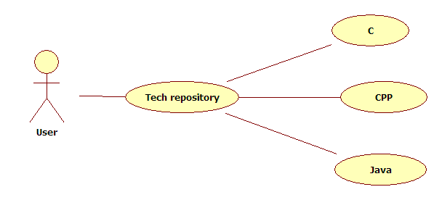
UML Diagrams
Use Case Diagram

Slide 11
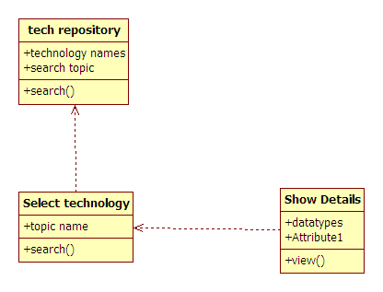
Class Diagram:

Slide 12
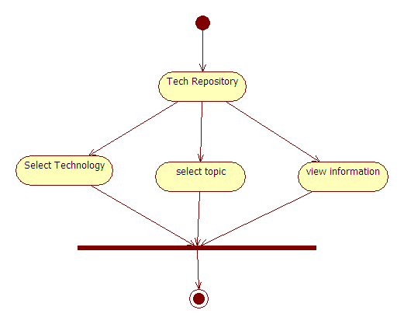
Activity Diagram:

Slide 13
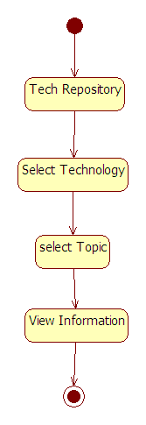
Statechart Diagram:

Slide 14
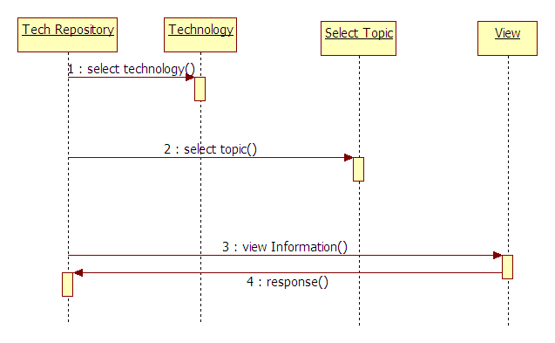
Sequence Diagram:

Slide 15
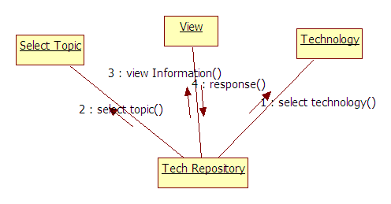
Collaboration Diagram:

Slide 16
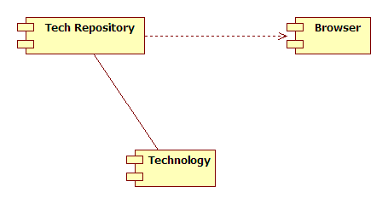
Component Diagram:

Slide 17

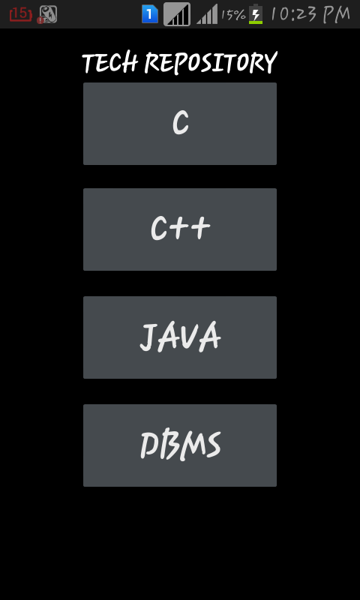
This is the home page.

Slide 18
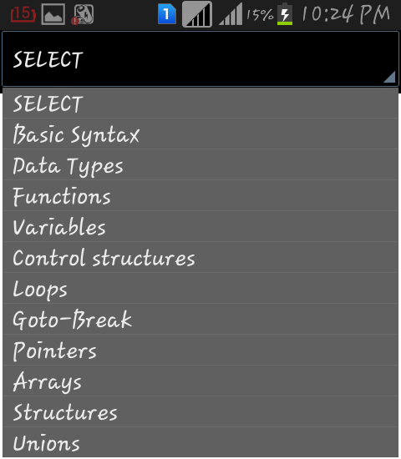
Whenever the user selects the C language then this page will be
displayed. Whatever topic user wants he/she can select it.

Slide 19
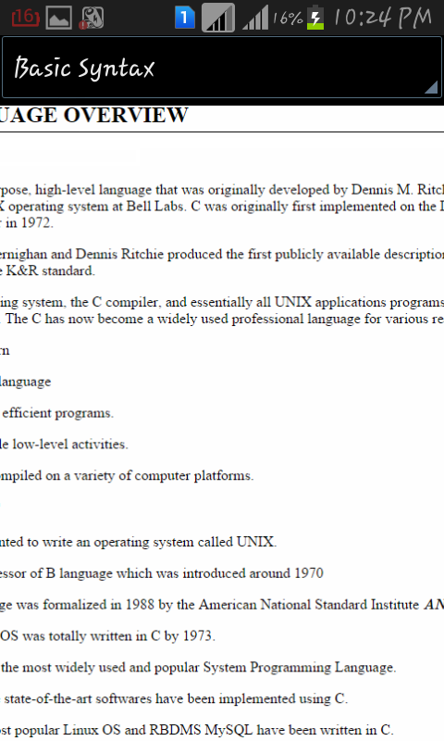
The selected topic will be displayed.

Slide 20
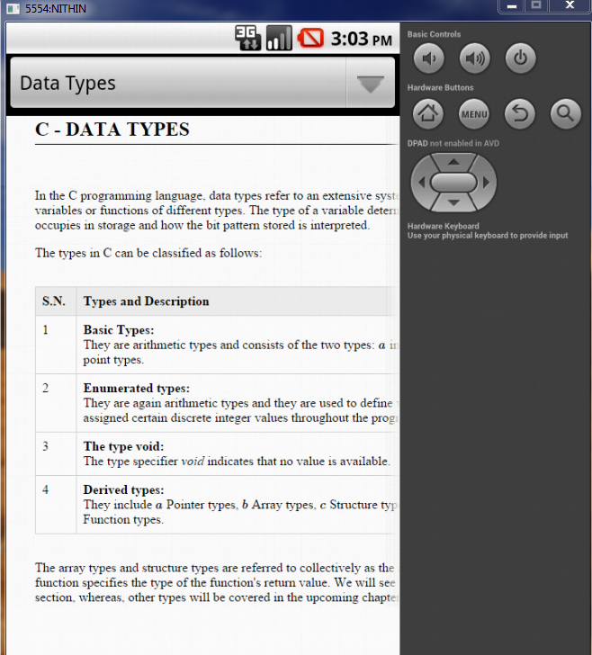

Slide 21
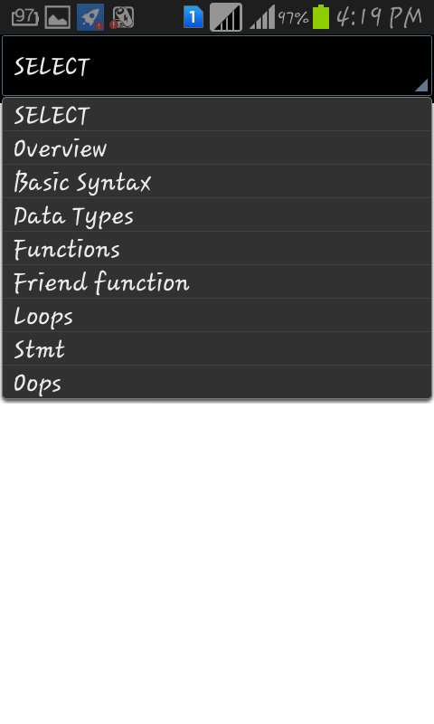
Whenever the user selects C++ this page will be displayed

Slide 22
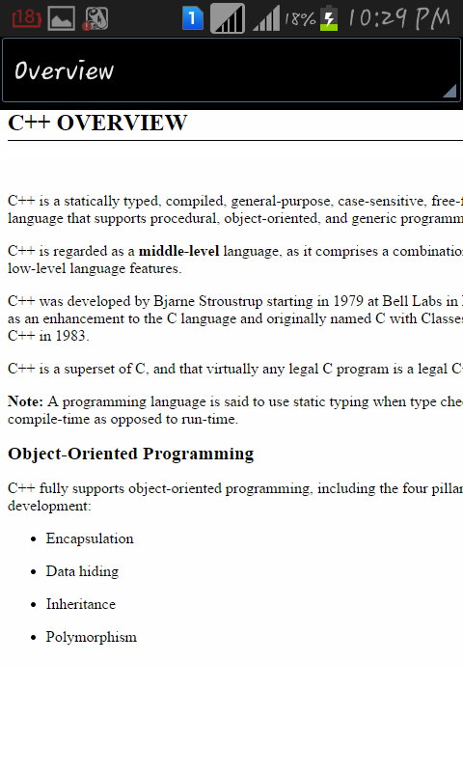

Slide 23
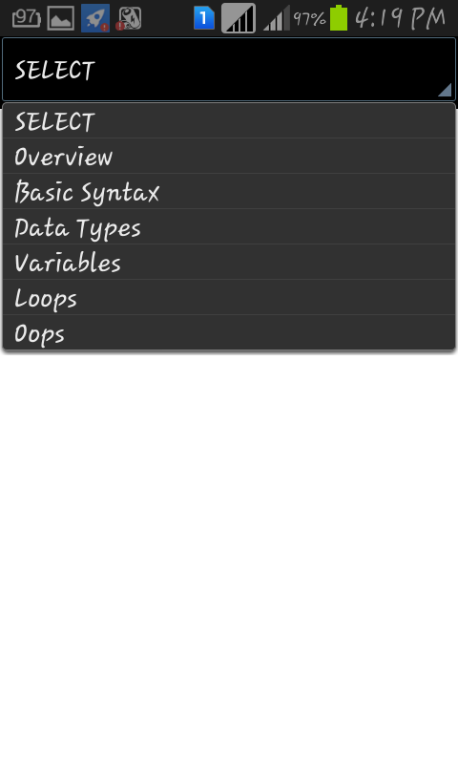
When the user selects java this page will be displayed.

Slide 24
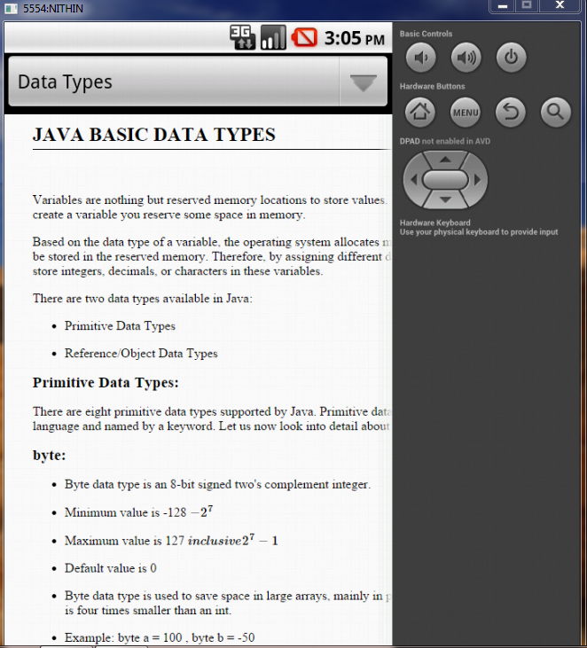

Slide 25
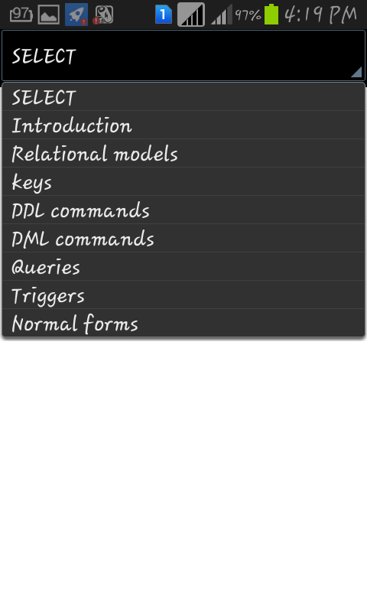
When the user selects Dbms this page will be displayed.

Slide 26
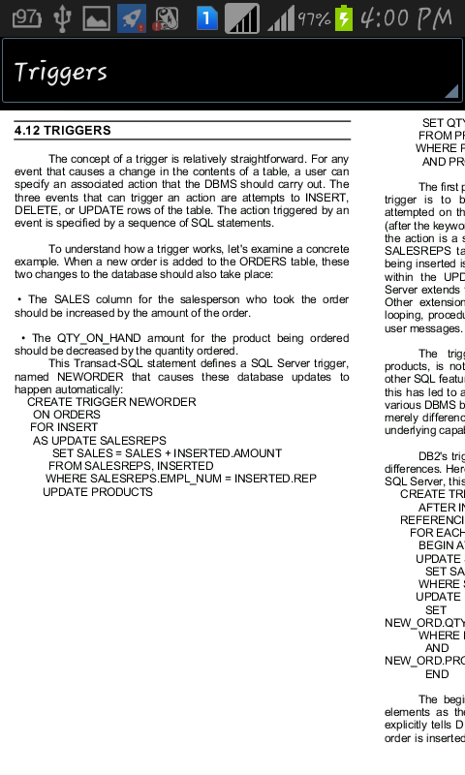

Slide 27
CONCLUSION
It is an app where multiple subjects can be read in a single place.
Important and useful material is fully covered in this app.
Its is very much advantageous for an interview attending person to recall the things fastly.
It needs no internet connectivity.

